Slide 1
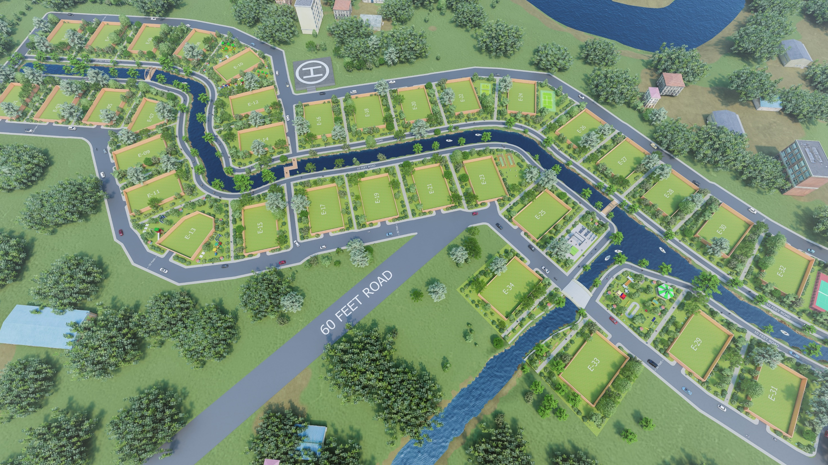

Slide 2
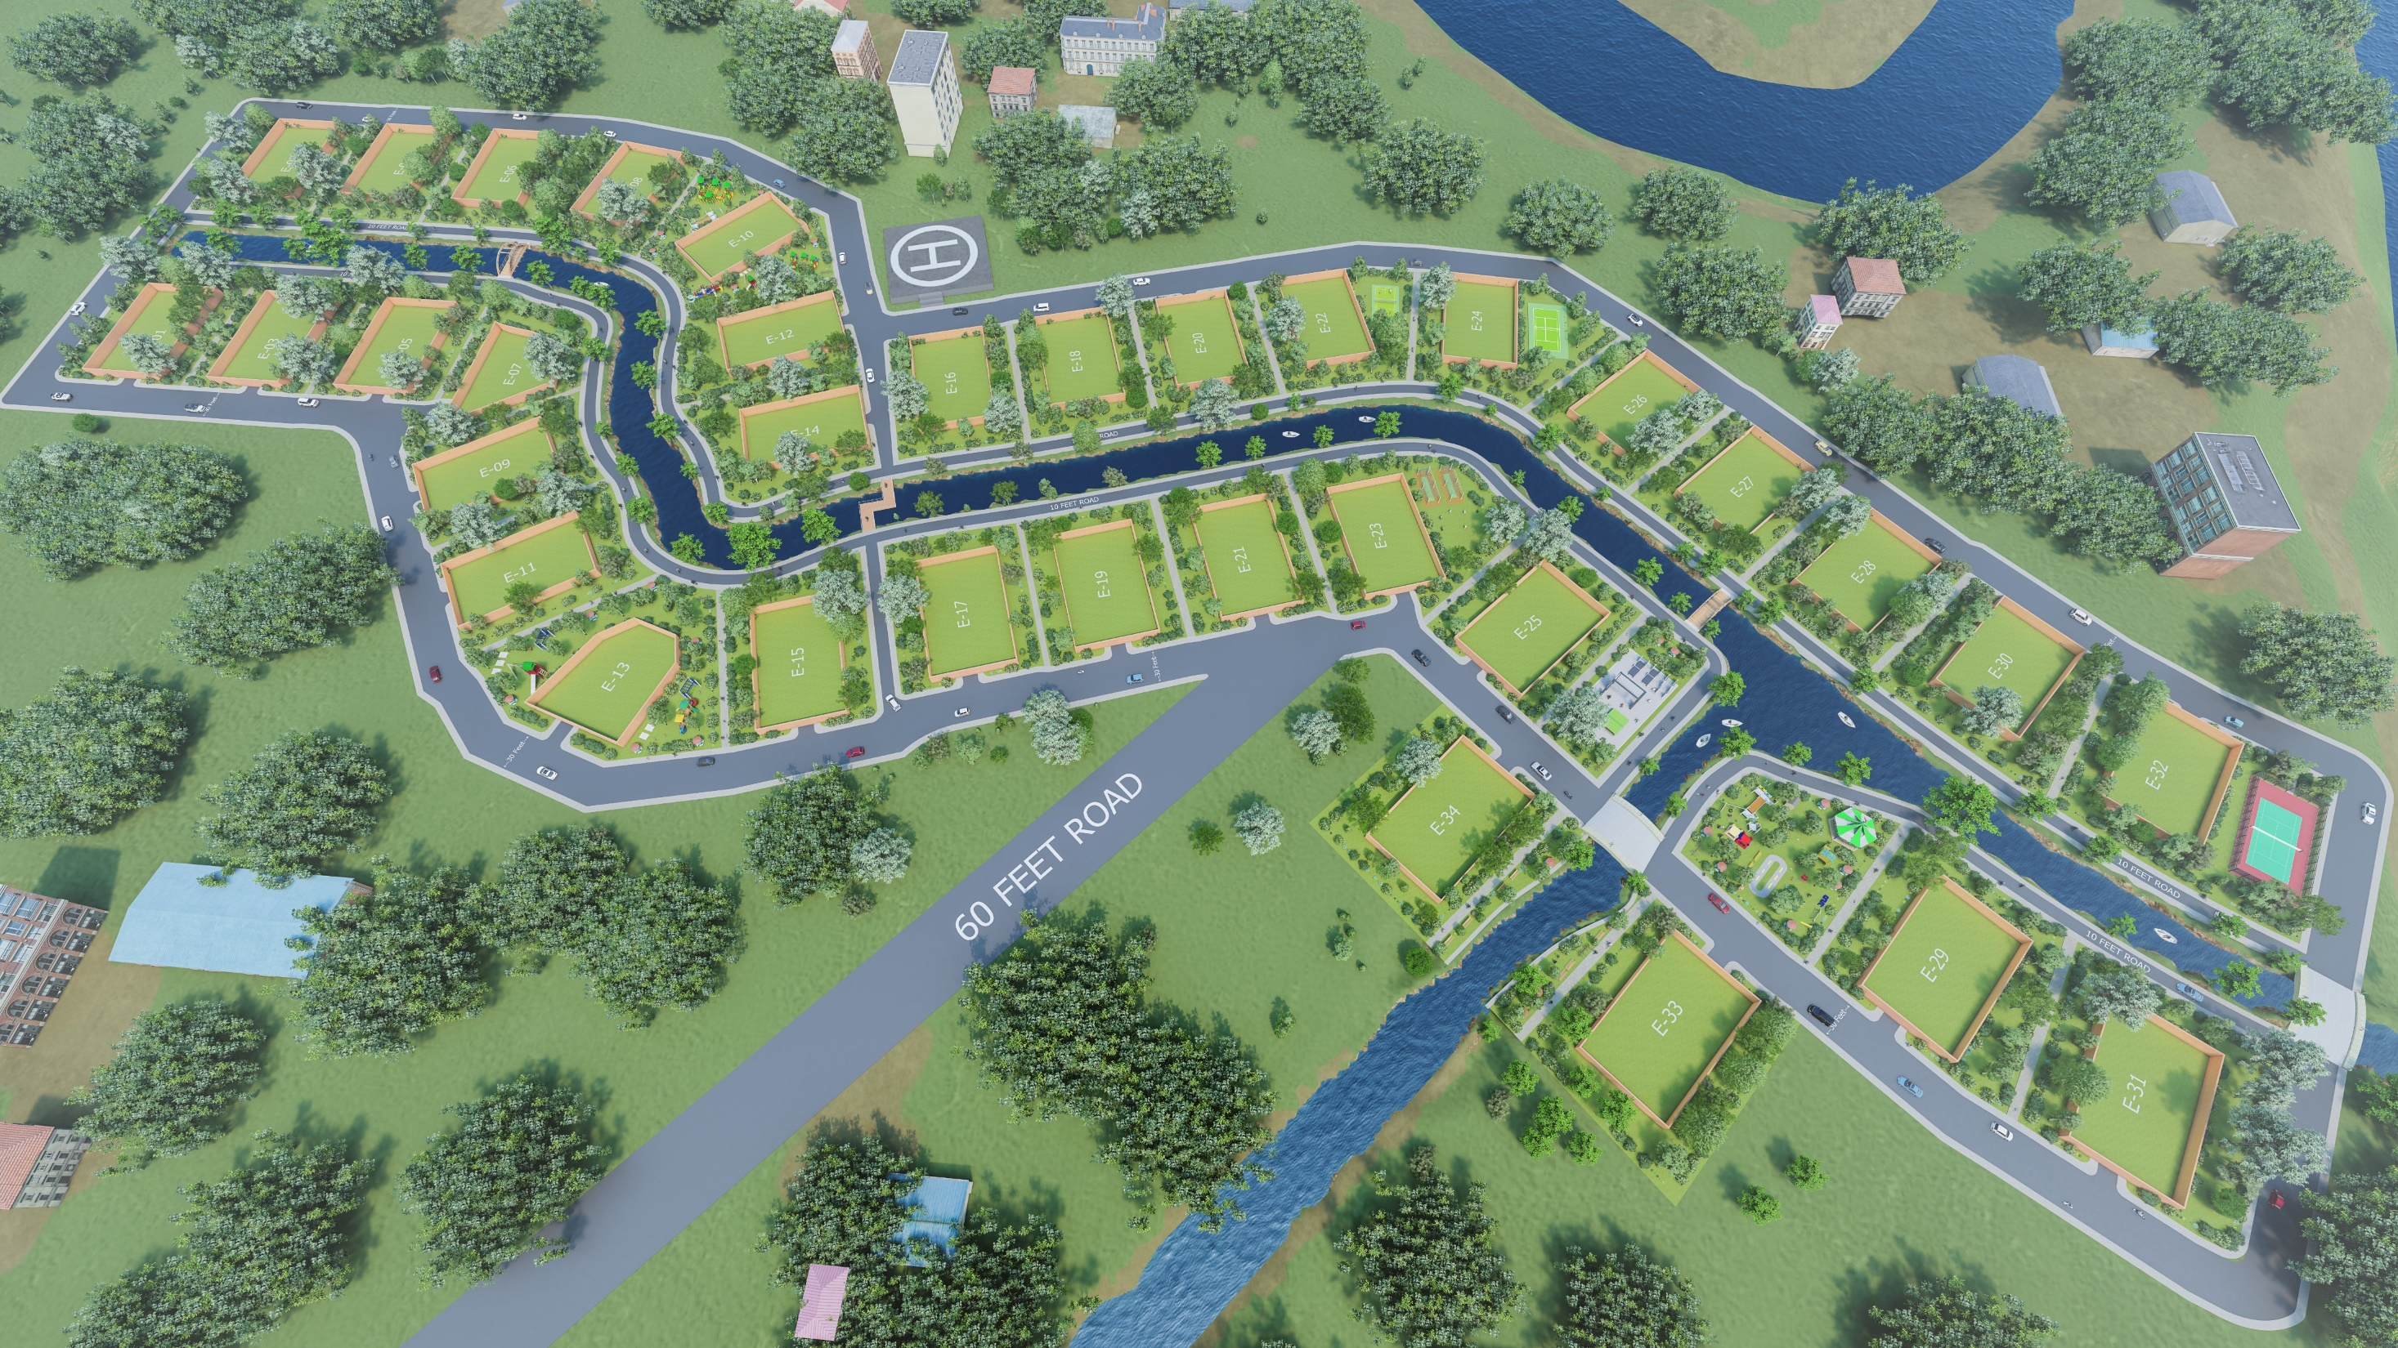

Slide 3
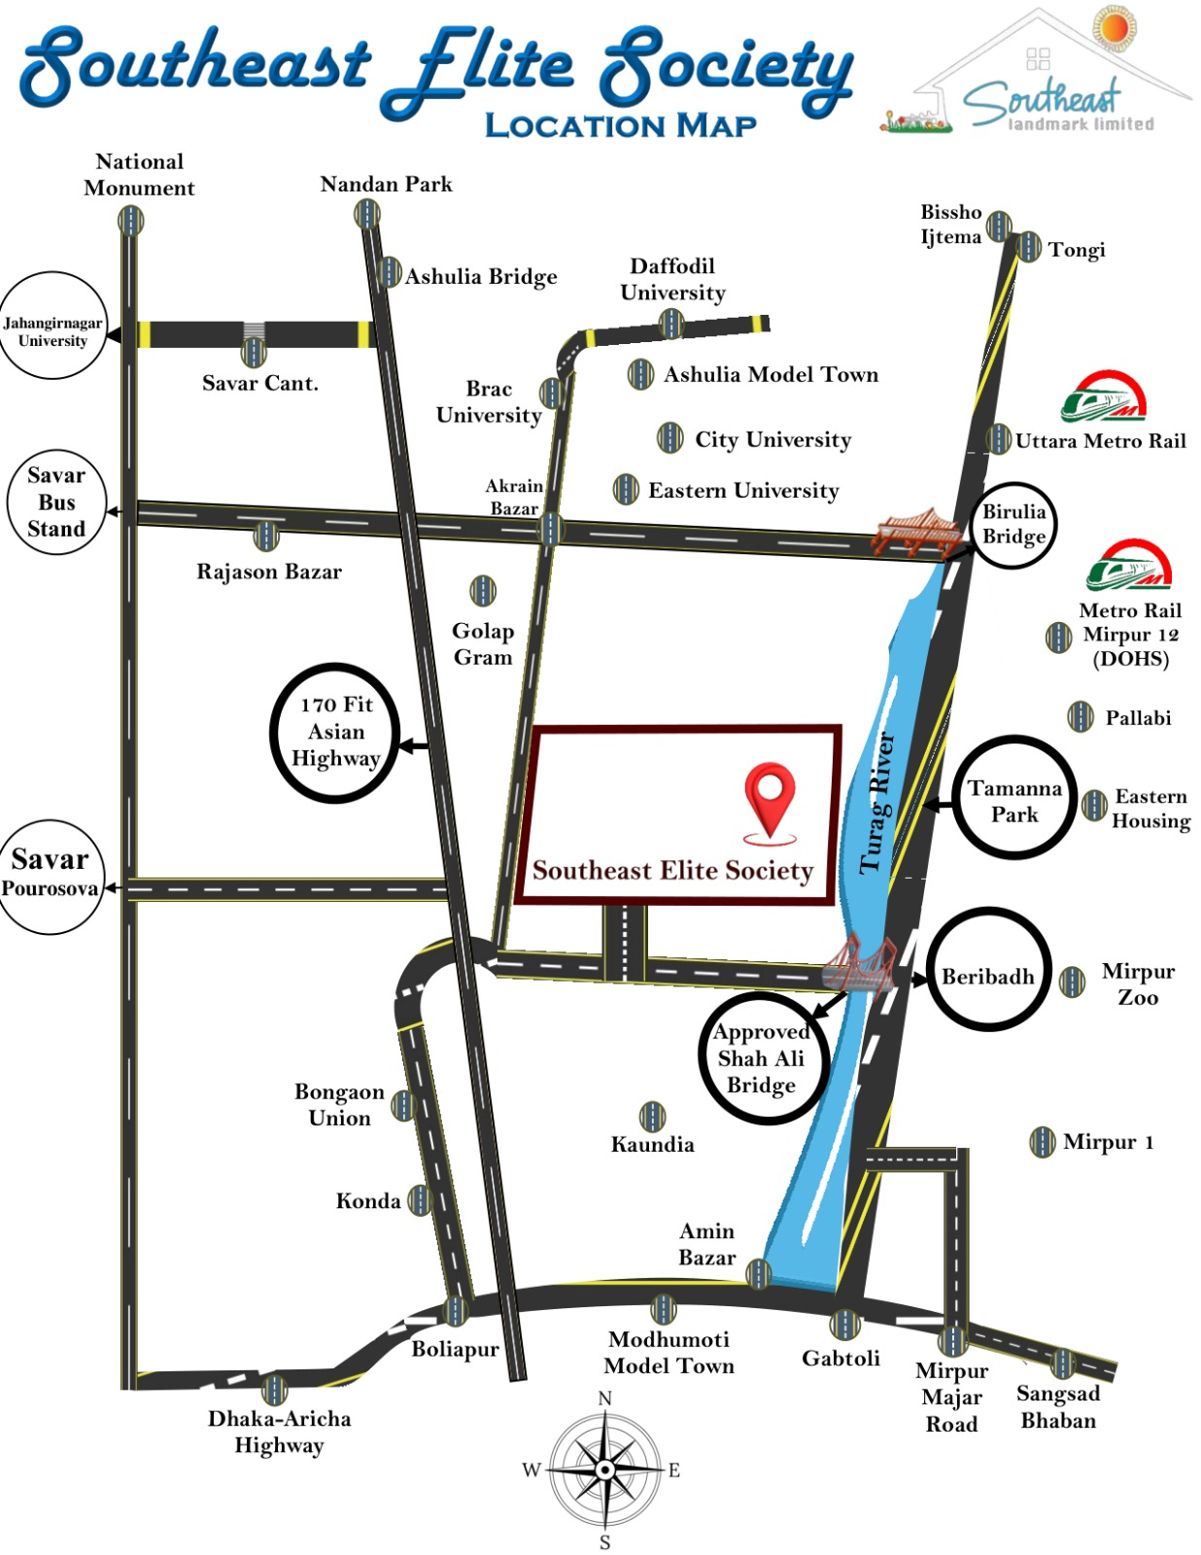
Location Map
SOUTHEAST ELITE SOCIETY

Slide 4
01 34 Plots
34 Bigha
02 Lakeshore Pathway
5.1 Bigha
02 Total Surrounding Road
10.95 Bigha
PROJECT SUMMARY
03 Total Lake
13.03 Bigha
04 Common Space
17.57 Bigha
TOTAL PROJECT
81.96 Bigha

Slide 5
P R O J E C T H I G H L I G H T S
03
Road Infrastructure
06
Enjoy 30 ft wide roads surrounding each plot
04
Pathway & Bicycle Path
01
Lake
Land Area
A picturesque 70 ft wide lake
A 10 ft wide pathway surrounds the lakeside & A 5 ft wide path along the lake shore
Sprawling across 901,828.8 SQFT.
02
05
Plots
Green Area
34 exclusive plots available.
Each Plot = 1 Bigha
199,584 SQFT of greenery, including trees, playgrounds,
and more.

Slide 6
Luxurious LIVING
03
Sporting Excellence
06
01
Lawn Tennis & Badminton Court
04
Elite Society
Recreation
Redefined
Helipad
Not just a Residence, but a Sanctuary of Luxury & Recreation (Only for 34 Owners)
Touch down in style with Helipad.
Discover a Heaven of Leisure & Activity.
02
Mini Golf Zone
05
Swing into luxury with mini golf zone
Cricket Paradise
Skill will be Hone at the Net Practicing Cricket Zone

Slide 7
F I N A N C I A L SNAPSHOT
PROJECTION
PROJECTION
PROJECTION
PROJECTION
1
2
3
4
Total Project Cost
Contingency (30%)
Total Investment Required
Per Plot Price
36,000,000 BDT per plot
399,131,880 BDT
119,739,564 BDT
518,871,444 BDT
Total Plot Sales Revenue
1,240,000,000 BDT

Slide 8
INVESTOR RETURN
312.5%
D
C
SHARE OWNERSHIP
B
20 INVESTORS
A
INVESTMENT APPEAL
Investors together will get 49% of ownership of a designated commercial space.
Return on Investment (ROI)
625,000,00 BDT (3.125 Times their Investment).
20,000,000 BDT.
Investment

Slide 9
F I N A N C I A L PROJECTIONS
03. PROFIT
741,128,556 BDT
(Total Revenue - Total Costs).
01. TOTAL COST
518,871,444 BDT (Project Cost + Contingency).
BDT
518,871,444
BDT 741,128,556
%
02. TOTAL REVENUE
143
1,240,000,000 BDT (Plot Sales) from lowest.
BDT
1,240,000,000
04. PROFIT RATIO
Approximately 143%.

Slide 10
I N V E S T M E N T OPPORTUNITY
INVESTORS
1
Seeking 20 Investors
EACH INVESTMENT
Each Investor Contributes 10,00,000 BDT.
2
RETURN ON
INVESTMENT (ROI)
Each Investor will Get
31,25,000 BDT.
(Within 3 Years)
3

Slide 11
Highly Profitable
Projected ROI of 312.5% speaks for itself.
Contingency/Subsidiary Cost
A built-in 30% contingency ensures risk mitigation.
Prime Location
Lakeside living, Green spaces, and Modern Amenities attract premium buyers.
Tangible Asset
Investors together will get 49% of ownership in a commercial space.
Secure and Protected Investment
Investors will get registration on commercial space aligned with shares, which will be tangible security for investment.
W H Y INVEST

Slide 12
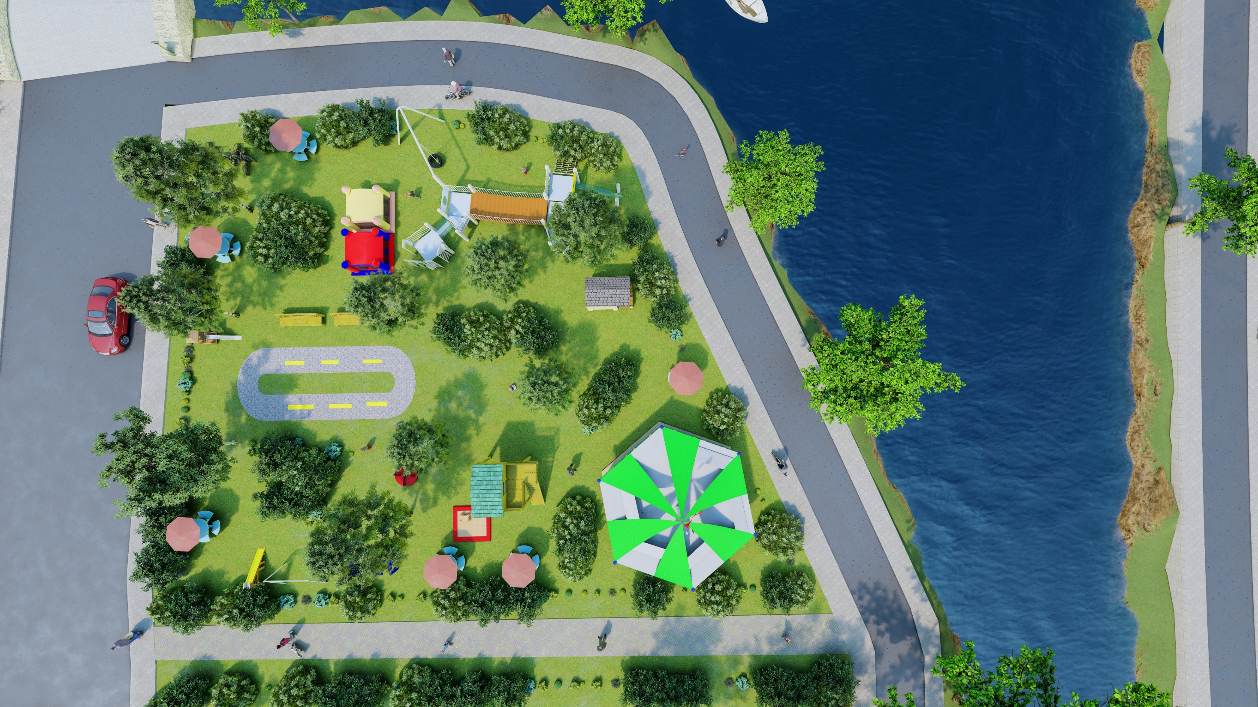
If you express interest
We Extend a Warm Invitation to Invest by

Slide 13
